Slide 1
Builder Pattern
Lutfun Nahar Lota
Assistant Professor, CSE

Slide 2
Builder Pattern
Builder pattern builds a complex object using simple objects and using a step by step approach.
This type of design pattern comes under creational pattern as this pattern provides one of the best ways to create an object.
A Builder class builds the final object step by step. This builder is independent of other objects.
Separate the construction of a complex object from its representation so that the same construction process can create different representations.

Slide 3
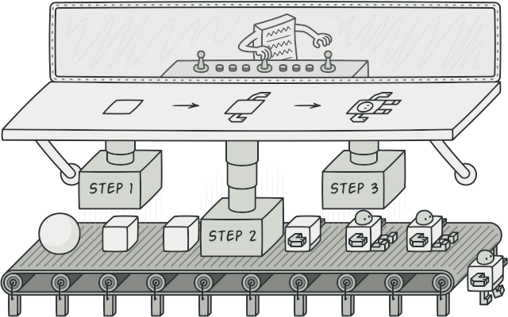
Builder Pattern
The Builder pattern lets you build objects step by step, using only those steps that you really need.

Slide 4
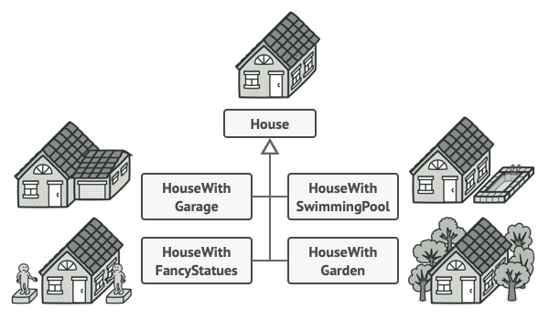
Builder Pattern
Problem
Imagine a complex object that requires laborious, step-by-step initialization of many fields and nested objects

Slide 5
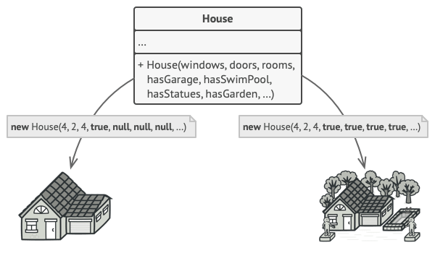
Builder Pattern
In most cases most of the parameters will be unused

Slide 6
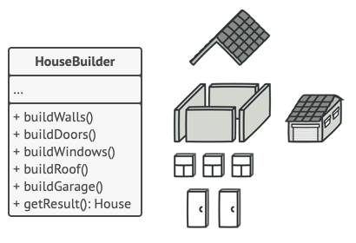
Builder Pattern
Solution
The Builder pattern suggests that, extract the object construction code out of its own class and move it to separate objects called builders

Slide 7
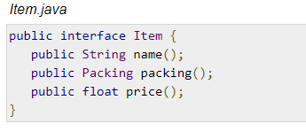
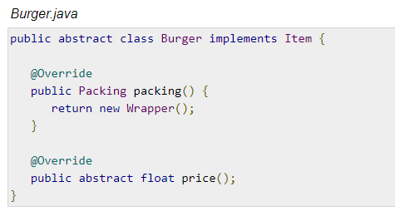
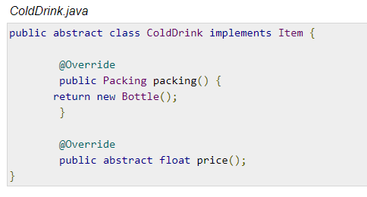
Builder Pattern

Slide 8
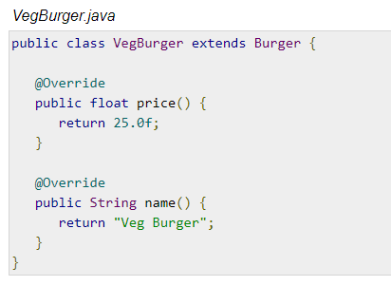
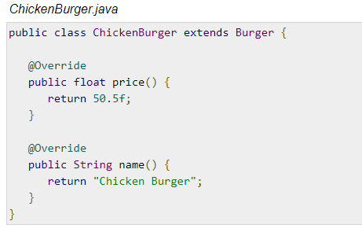
Builder Pattern

Slide 9
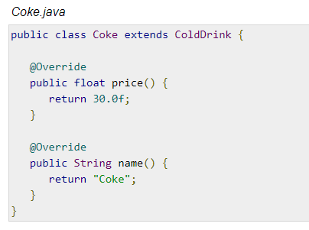
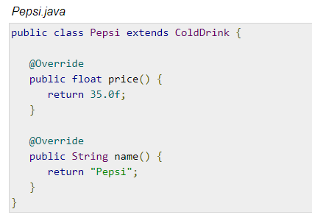
Builder Pattern

Slide 10
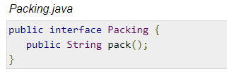
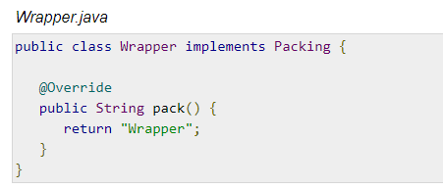
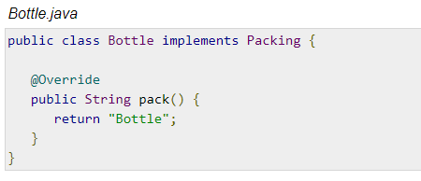
Builder Pattern

Slide 11
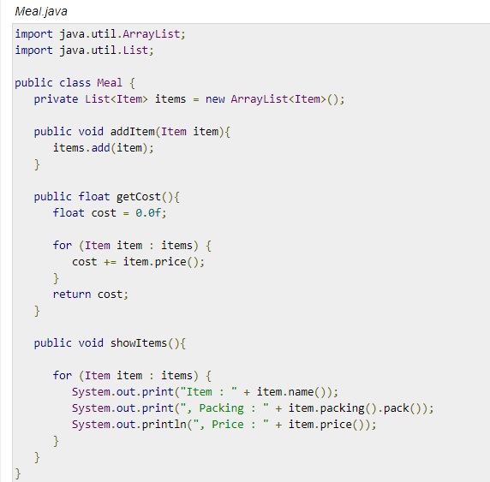
Builder Pattern

Slide 12
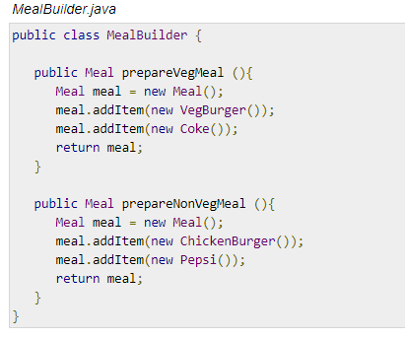
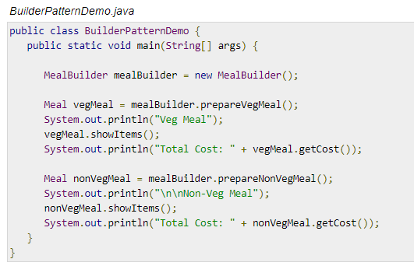
Builder Pattern

Slide 13
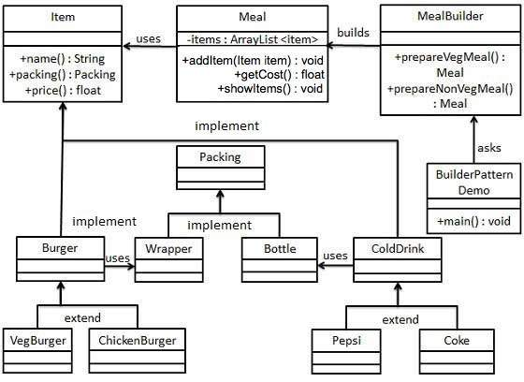
UML Diagram of Builder Pattern

Slide 14
H/W
Which patterns are related or similar to Builder?
Difference between Factory and Builder?
Think some real life scenario where builder pattern can be used?

Slide 15
Composite Pattern
Composite pattern is used where we need to treat a group of objects in similar way as a single object. Composite pattern composes objects in term of a tree structure to represent part as well as whole hierarchy. This type of design pattern comes under structural pattern as this pattern creates a tree structure of group of objects.
work with these structures as if they were individual objects.

